Slide 1

Using R for Scalable Data Analytics: Single Machines to Spark Clusters
John-Mark Agosta, Hang Zhang, Robert Horton, Mario Inchiosa, Katherine Zhao, Vanja Paunic and Debraj GuhaThakurta
Microsoft
Srini Kumar, LevaData, Inc.
Acknowledgement: Ali-Kazim Zaidi
TUTORIAL MATERIAL & SLIDES: tinyurl.com/Strata2017R
ROOM: LL21 C/D, San Jose Convention Center
TIME: 9:00am - 12:30pm, March 14th, 2017
1

Slide 2
Tutorial Outline
Introduction - scaling your R scripts [~15 mins]
Scaling R on Spark: Hands-on tutorials w/ presentation [~140 mins]
SparkR
sparklyr
RevoScaleR
Brief demos/presentations [20 mins]
DNN on R (image recognition) [~10 mins]
Other options for scaling R [~10 mins]
Q&A [15 mins]
15 min break after ~ 1 ½ hrs
2

Slide 3
Introduction - Scaling your R scripts
Katherine Zhao
3

Slide 4
Introduction
What is R?
What limits the scalability of R scripts?
What functions and techniques can be used to overcome those limits?
4

Slide 5

Language
Platform
What is
The most popular statistical programming language
A data visualization tool
Open source
2.5+M users
Community
Taught in most universities
Many common use cases across industry
Thriving user groups worldwide
5th in 2016 IEEE Spectrum rank
42% pro analysts prefer R (highest amongst R, SAS, python)
Ecosystem
10,000+ contributed packages
Rich application & platform integration
5

Slide 6
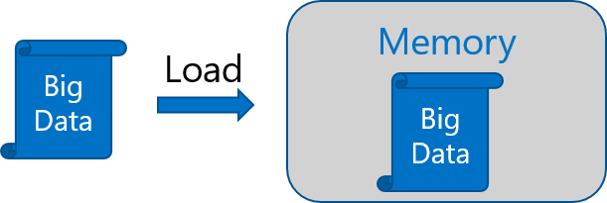
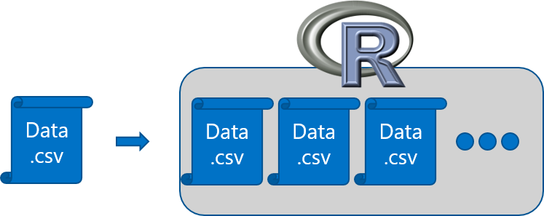
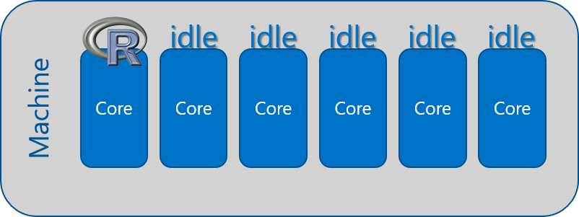
R adoption is on a Tear But there are several issues regarding scalability
In-Memory Operation
Expensive Data Movement
& Duplication
Lack of Parallelism
6

Slide 7
Couple of scalable R solutions
R packages for distributed computing [Hands-on]
SparkR
sparklyr
RevoScaleR (Microsoft R Server)
h2o
and more!
R packages with big data support on single machines
The bigmemory project
ff and related packages
foreach with doParallel, doSNOW, doNWS backends
7

Slide 8
Hands-on Tutorials w/ Presentations Part I: SparkR and sparklyr [70 mins]
Katherine Zhao
Debraj GuhaThakurta
Srini Kumar
Hang Zhang
Acknowledgement: Ali-Kazim Zaidi
8

Slide 9
Distributed computing on Spark
Brief intro to Spark, its APIs and OS R packages
9

Slide 10
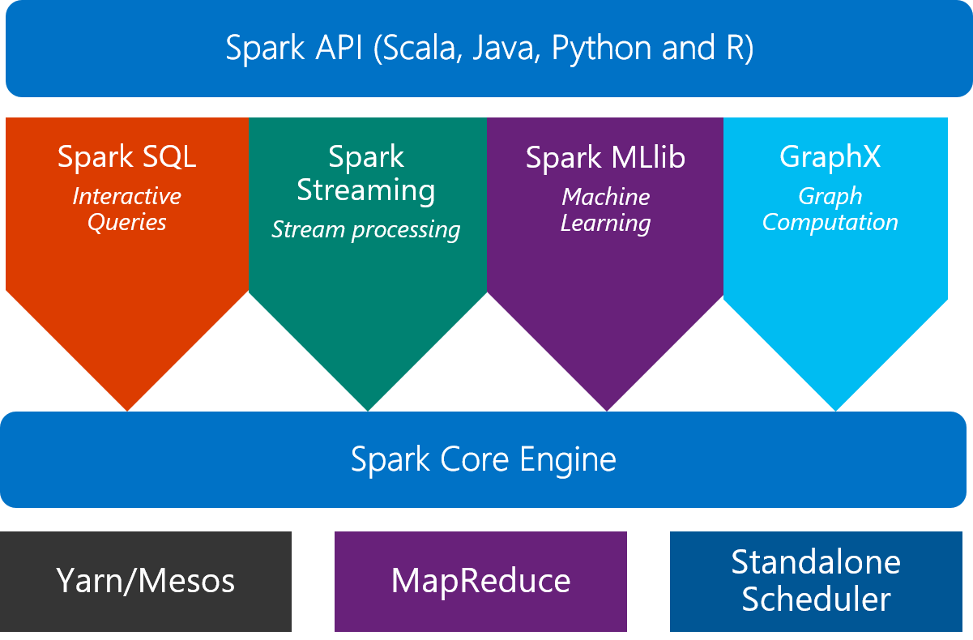
Scale on Spark clusters
What is Spark?
An unified, open source, parallel, data processing framework for Big Data Analytics
10

Slide 11

SparkR 2.0: a Spark API
An R package provides a light-weight frontend to use Apache Spark from R and allows data scientists to analyze large datasets.
SparkDataFrame is distributed collection of data organized into named columns.
SparkR can create SparkDataFrames from local R data frames, csv, json and parquet files.
With Hive support, it can also access tables from Hive MetaStore.
Pre-configured on Spark clusters in Azure HDInsight.
11

Slide 12
Data processing and modeling with SparkR
Supports functions for structured data processing:
Selections: select(), filter()
Grouping, Aggregations: summarize(), arrange()
Running local R functions distributed: spark.lapply()
Applying UDFs on each partition/group of a SparkDataFrame: dapply(), dapplyCollect(), gapply(), gapplyCollect()
Uses MLlib to train models and allows model persistence.
Generalized Linear Model
Survival regression
Naive Bayes
KMeans
Logistic Regression
Gradient Boosted Tree
Random Forest
… others
12

Slide 13
General analytical workflow in Spark
(across multiple toolkits)
Ingest into Spark DF
Wrangling and cleanup (Spark SQL, dplyr)
Creation of ML models in Spark
+
Model evaluation
Exploration and visualization
(for visualization, sampled data may need to be converted to R dataframe)
Transfor-mation and Featurization
(in Spark SQL or featurization functions)
Save models for deployment
Spark dataframes used multiple times in the workflow should be cached in memory
13

Slide 14
Platforms & Services for Hands-on
14

Slide 15






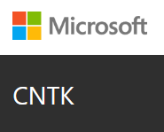






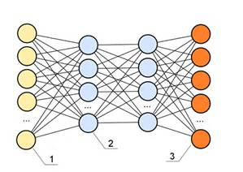





Single node Azure Linux DSVM w/ Spark (for Hands-On)
Data-science virtual machine
Vowpal Wabbit
xgboost
Rattle
Spark 2.0.2
HDFS (local)
Yarn
Developer edition
CNTK
http://aka.ms/dsvm
15

Slide 16
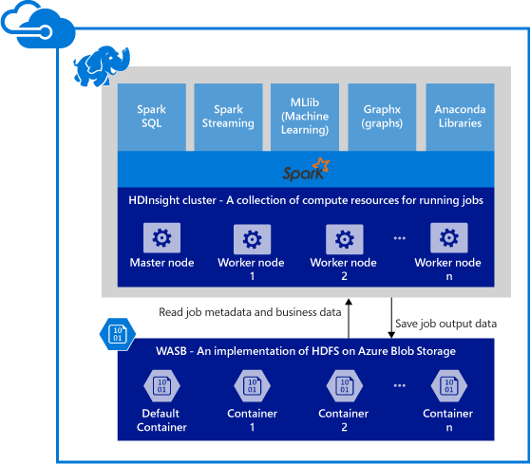
Spark clusters in Azure HDInsight
Provisions Azure compute resources with Spark 2.0.2 installed and configured.
Supports multiple versions (e.g. Spark 1.6).
Stores data in Azure Blob storage (WASB), Azure Data Lake Store or Local HDFS.
16

Slide 17
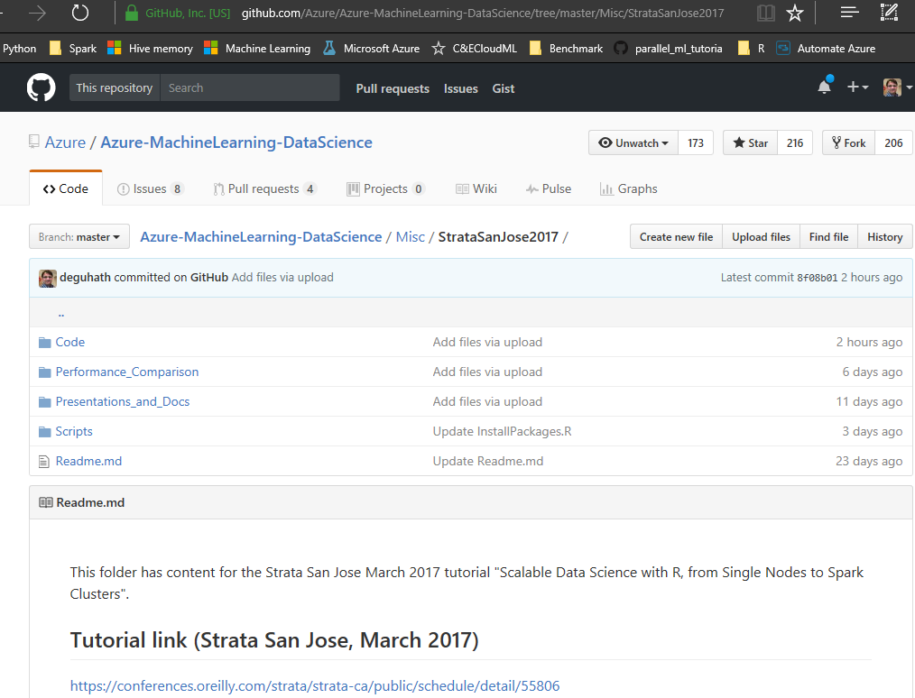
GitHub repository for all code and scripts
tinyurl.com/Strata2017R
17

Slide 18
SparkR Hands-on
Debraj GuhaThakurta
Srini Kumar
18

Slide 19


Model deployment using R-server operationalization services
Easy Consumption
Explore and consume services in R directly
Data Scientist
Easy Deployment
Turn R into web services in one line of code
Microsoft R Client
(mrsdeploy package)
Data Scientist
Services / Sessions
getService
Microsoft R Client
(mrsdeploy package)
publishService
Microsoft R Server
configured for
operationalizing R analytics
REST API calls
Easy Setup
In-cloud or on-prem
Adding nodes to scale
High availability & load balancing
Remote execution server
Apps
Easy Integration
Swagger-based APIs: easy to consume with any programming language
Developer
19

Slide 20

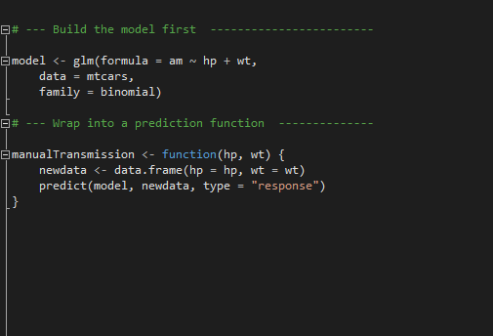
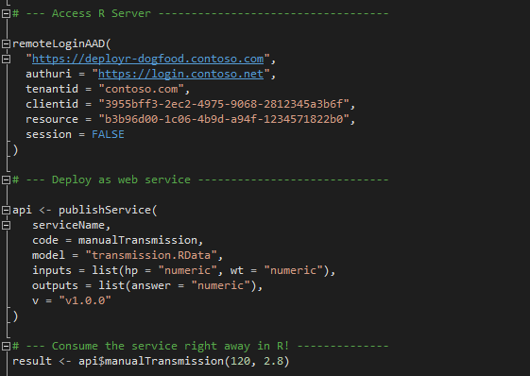
Deployment Turn R into Web Services easily; and consume them in R
Build the model first
Deploy as a web service instantly
Package: mrsdeploy
https://msdn.microsoft.com/en-us/microsoft-r/operationalize/configuration-initial
https://msdn.microsoft.com/en-us/microsoft-r/operationalize/admin-utility
20

Slide 21
mrsdeploy Hands-on
Debraj GuhaThakurta
21

Slide 22
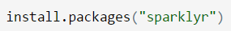
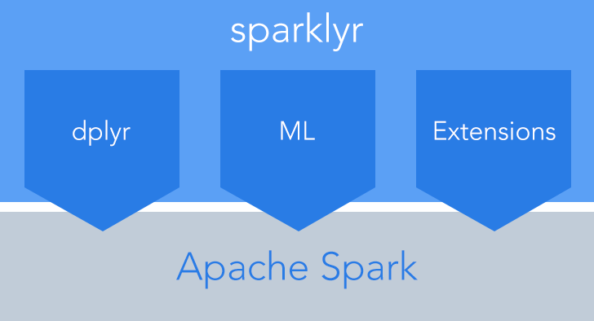
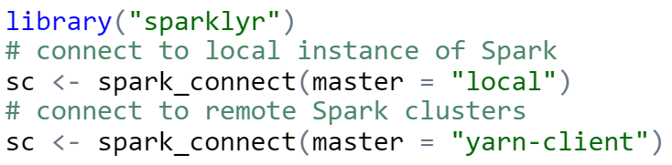
sparklyr: R interface for Apache Spark
Easy installation from CRAN
Connect to both local instances of Spark and remote Spark clusters
Loads data into SparkDataFrame from: local R data frames, Hive tables, CSV, JSON, and Parquet files.
Source: http://spark.rstudio.com/
22

Slide 23
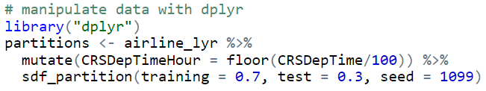
dplyr and ML in sparklyr
Provides a complete dplyr backend for data manipulation, analysis and visualization
%>%
Includes 3 family of functions for machine learning pipeline
ml_*: Machine learning algorithms for analyzing data provided by the spark.ml package.
K-Means, GLM, LR, Survival Regression, DT, RF, GBT, PCA, Naive-Bayes, Multilayer Perceptron, LDA
ft_*: Feature transformers for manipulating individual features.
sdf_*: Functions for manipulating SparkDataFrames.
23

Slide 24
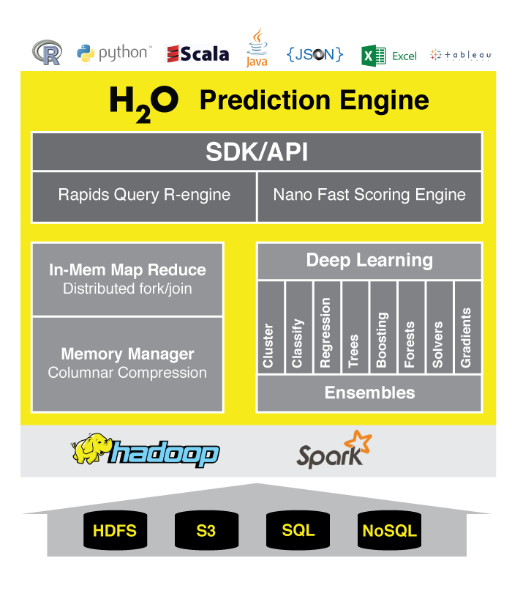
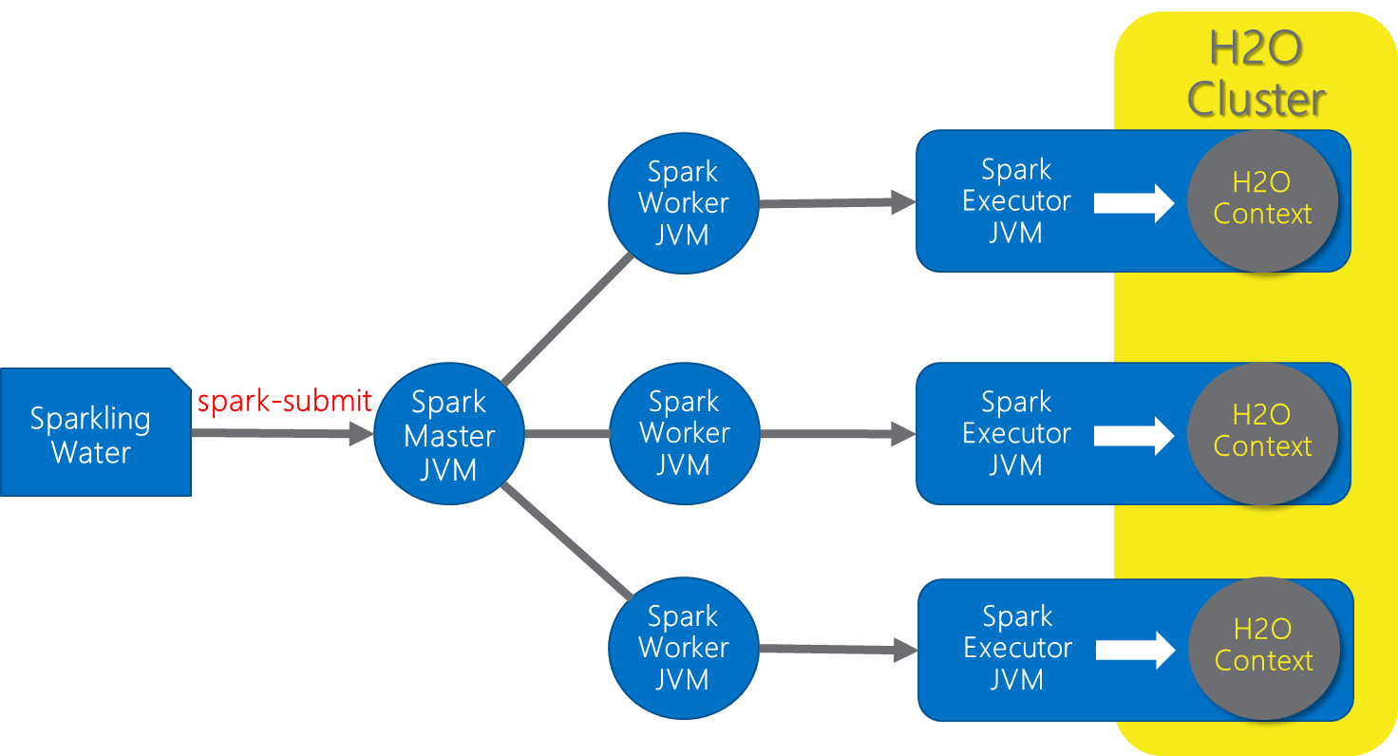
h2o: prediction engine in R
Optimized for “in memory” processing of distributed, parallel machine learning algorithms on clusters.
Sparkling Water = h2o + Spark
Data manipulation and modeling: R functions + h2o pre-fixed functions.
Transformations: h2o.group_by(), h2o.impute()
Statistics: h2o.summary(), h2o.quantile(), h2o.mean()
Algorithms: h2o.glm(), h2o.naiveBayes(), h2o.deeplearning(), h2o.kmeans()
http://www.h2o.ai/product/
24

Slide 25
sparklyr Hands-on
Debraj GuhaThakurta
25

Slide 26
15 min break
26

Slide 27
Hands-on Tutorials w/ Presentation Part II: RevoScaleR [70 mins]
Mario Inchiosa
Robert Horton
Vanja Paunic
John-Mark Agosta
Katherine Zhao
27

Slide 28
Hands-on Tutorial:
Airline Arrival Delay Prediction using R Server and SparkR
Mario Inchiosa
28

Slide 29
R Server 9.0: scale-out R, Enterprise Class!
100% compatible with open source R
Any code/package that works today with R will work in R Server.
Ability to parallelize any R function
Ideal for parameter sweeps, simulation, scoring.
Wide range of scalable and distributed rx pre-fixed functions in RevoScaleR package.
Transformations: rxDataStep()
Statistics: rxSummary(), rxQuantile(), rxChiSquaredTest(), rxCrossTabs()…
Algorithms: rxLinMod(), rxLogit(), rxKmeans(), rxBTrees(), rxDForest()…
Parallelism: rxSetComputeContext()
29

Slide 30

Azure HDInsight + R Server: Managed Hadoop for Advanced Analytics in the Cloud
R
Easy setup, elastic, SLA
Ubuntu Linux
Cloud Storage
Spark
R Server
Leverage R skills with massively scalable algorithms and statistical functions
Reuse existing R functions over multiple machines
SparkR functions
RevoScaleR functions
Spark and Hadoop
Blob Storage
Data Lake Storage

Slide 31


R Server Hadoop Architecture
1. R Server Local Processing:
Data in Distributed Storage
R process on Edge Node
Data Scientists
Edge Node
Data Nodes
R
R
R
R
R
Head Nodes
2. R Server Distributed Processing:
Master R process on Edge Node
Apache YARN and Spark
Worker R processes on Data Nodes
R
R
R
R
R
R Server

Slide 32
R Server on Hadoop/HDInsight scales to hundreds of nodes, billions of rows and terabytes of data
2.2 TB

Slide 33
Typical advanced analytics lifecycle
Prepare: Assemble, cleanse, profile and transform diverse data relevant to the subject.
Model: Use statistical and machine learning algorithms to build classifiers and regression models
Operationalize: Make predictions and visualizations to support business applications
Prepare
Model
Operationalize

Slide 34
Airline Arrival Delay Prediction Demo
Clean/Join – Using SparkR from R Server
Train/Score/Evaluate – Scalable R Server functions
Deploy/Consume – Using mrsdeploy from R Server

Slide 35
Airline data set
Passenger flight on-time performance data from the US Department of Transportation’s TranStats data collection
>20 years of data
300+ Airports
Every carrier, every commercial flight
http://www.transtats.bts.gov

Slide 36
Weather data set
Hourly land-based weather observations from NOAA
> 2,000 weather stations
http://www.ncdc.noaa.gov/orders/qclcd/

Slide 37
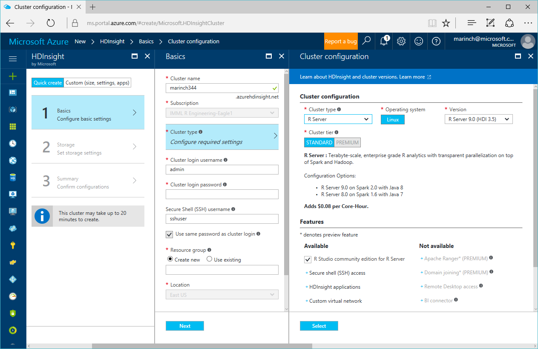
Provisioning a cluster with R Server

Slide 38
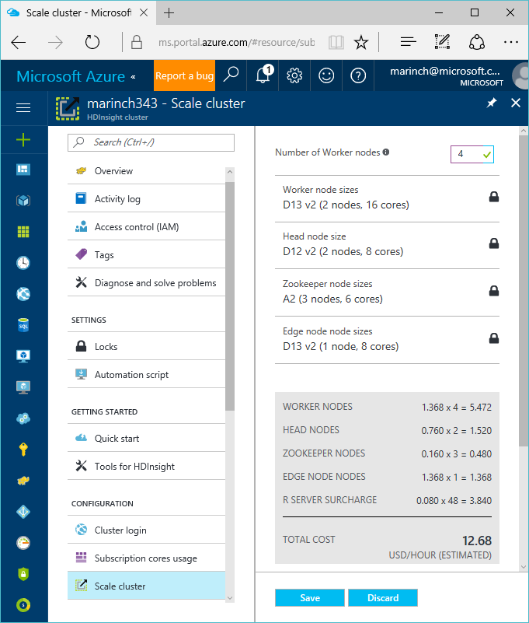
Scaling a cluster

Slide 39
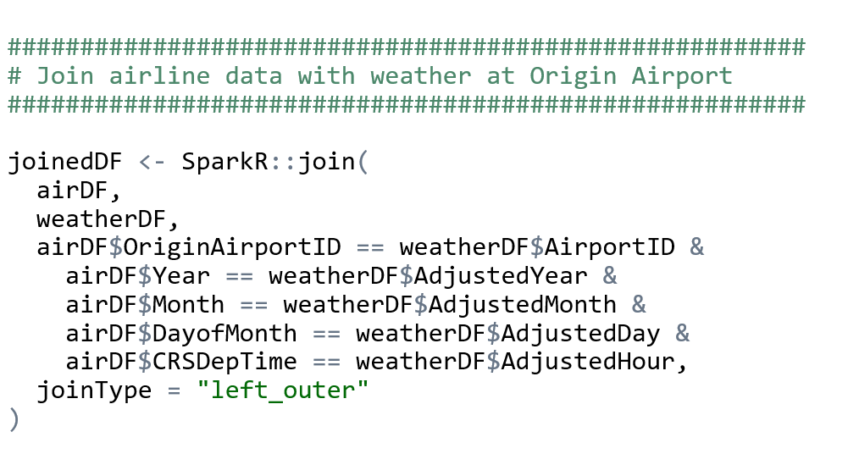
Clean and Join using SparkR in R Server

Slide 40
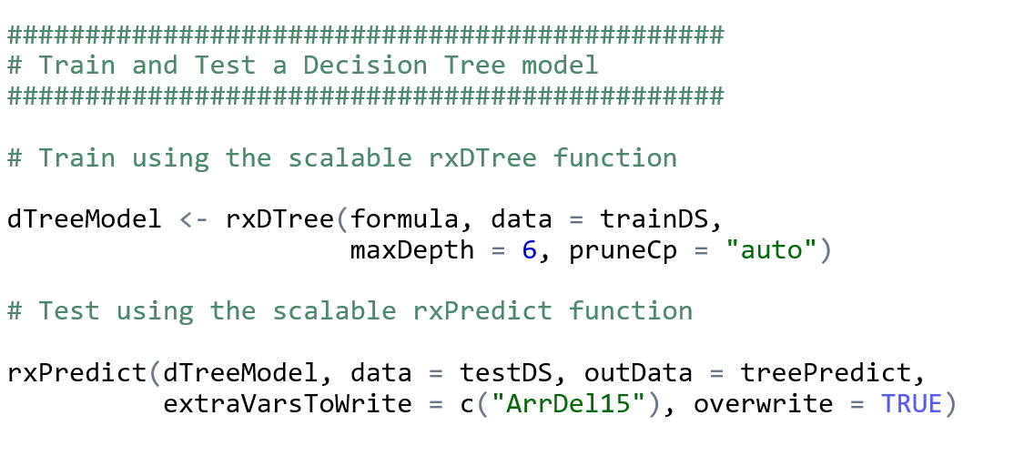
Train, Score, and Evaluate using R Server

Slide 41
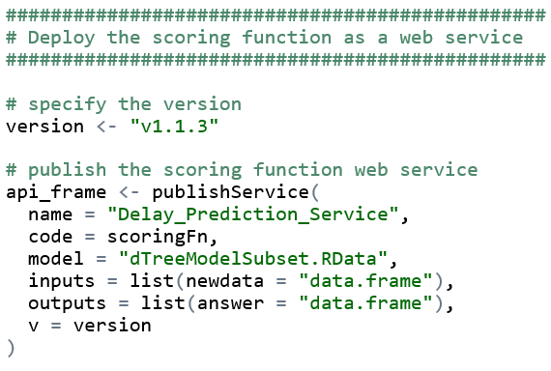
Publish Web Service from R

Slide 42
Demo Technologies Review
HDInsight Premium Hadoop cluster
Data Science Virtual Machine
Spark on YARN distributed computing
R Server R interpreter
SparkR data manipulation functions
RevoScaleR Statistical & Machine Learning functions
mrsdeploy web service operationalization

Slide 43
Distributed model training and parameter optimization:
Learning Curves on Big Data
Robert M. Horton, PhD MS
Senior Data Scientist
43

Slide 44
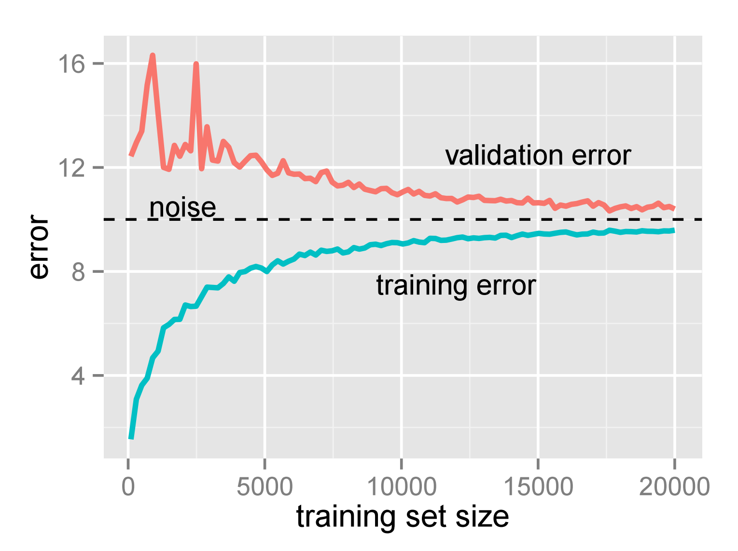
Learning Curve

Slide 45
Simulated Data
A | B | C | D | E | F | G | H | I | J | y
a00002 | b00001 | c00003 | d00002 | e00026 | f00011 | g00043 | h00142 | i00049 | j00161 | -19.4032
a00001 | b00002 | c00004 | d00013 | e00024 | f00047 | g00037 | h00139 | i00068 | j00164 | 28.2963
a00002 | b00002 | c00002 | d00004 | e00017 | f00002 | g00086 | h00141 | i00059 | j00447 | -8.9377
a00001 | b00002 | c00001 | d00003 | e00012 | f00004 | g00066 | h00050 | i00163 | j00714 | -27.9605
a00001 | b00003 | c00001 | d00002 | e00004 | f00016 | g00011 | h00097 | i00163 | j00246 | 27.3483
a00002 | b00001 | c00001 | d00003 | e00023 | f00006 | g00002 | h00072 | i00249 | j00188 | 4.7853
a00001 | b00003 | c00007 | d00010 | e00002 | f00006 | g00036 | h00031 | i00250 | j00179 | 25.9673
a00002 | b00003 | c00004 | d00016 | e00017 | f00004 | g00029 | h00077 | i00168 | j00020 | 27.1069
a00001 | b00001 | c00002 | d00011 | e00003 | f00033 | g00047 | h00115 | i00310 | j00280 | 9.5063
a00001 | b00001 | c00004 | d00006 | e00006 | f00040 | g00086 | h00014 | i00002 | j00374 | -19.5206
a00001 | b00002 | c00001 | d00002 | e00004 | f00028 | g00044 | h00005 | i00431 | j00646 | -4.0899
a00001 | b00003 | c00002 | d00006 | e00018 | f00044 | g00040 | h00232 | i00254 | j00261 | 19.7420
a00002 | b00002 | c00007 | d00003 | e00011 | f00012 | g00081 | h00071 | i00291 | j00023 | 7.9582
a00002 | b00003 | c00004 | d00012 | e00005 | f00006 | g00056 | h00182 | i00430 | j00615 | -37.2846
a00001 | b00002 | c00007 | d00001 | e00026 | f00022 | g00033 | h00157 | i00067 | j00039 | 3.6434
Y
Increasing cardinality

Slide 46
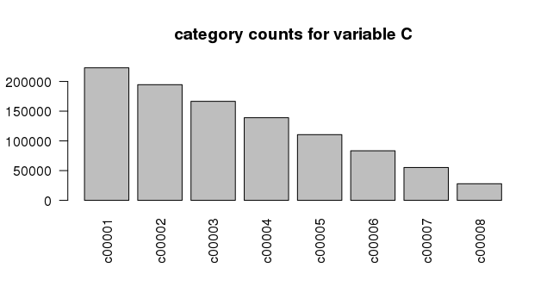

Slide 47
Parameter Table
model_class | training_fraction | with_formula | test_set_kfold_id | KFOLDS | cube
rxLinMod | 0.0150000 | y ~ D+C+B+A | 1 | 3 | TRUE
rxLinMod | 0.0219736 | y ~ D+C+B+A | 1 | 3 | TRUE
rxLinMod | 0.0321893 | y ~ D+C+B+A | 1 | 3 | TRUE
rxLinMod | 0.0471543 | y ~ D+C+B+A | 1 | 3 | TRUE
rxLinMod | 0.0690766 | y ~ D+C+B+A | 1 | 3 | TRUE
rxLinMod | 0.1011907 | y ~ D+C+B+A | 1 | 3 | TRUE
rxLinMod | 0.1482349 | y ~ D+C+B+A | 1 | 3 | TRUE
rxLinMod | 0.2171503 | y ~ D+C+B+A | 1 | 3 | TRUE
rxLinMod | 0.3181049 | y ~ D+C+B+A | 1 | 3 | TRUE
rxLinMod | 0.4659939 | y ~ D+C+B+A | 1 | 3 | TRUE
rxLinMod | 0.6826375 | y ~ D+C+B+A | 1 | 3 | TRUE
rxLinMod | 1.0000000 | y ~ D+C+B+A | 1 | 3 | TRUE
rxLinMod | 0.0150000 | y ~ E+D+C+B+A | 1 | 3 | TRUE
rxLinMod | 0.0219736 | y ~ E+D+C+B+A | 1 | 3 | TRUE
rxLinMod | 0.0321893 | y ~ E+D+C+B+A | 1 | 3 | TRUE
… | … | … | … | … | …

Slide 48
Dynamic Sampling
row_tagger:
set.seed(chunk_num + salt)
kfold <- sample(1:kfolds, size=num_rows,
replace=TRUE)
in_test_set <- kfold == kfold_id
num_training_candidates <- sum(!in_test_set)
keepers <- sample(rowNums[!in_test_set],
prob * num_training_candidates)
data_list$in_training_set <- rowNums %in% keepers
data_list$in_test_set <- in_test_set

Slide 49
Dynamic Scoring
On each chunk:
residual <- rxPredict(model, <selected cases>)
SSE <- SSE + sum(residual^2, na.rm=TRUE)
rowCount <- rowCount + sum(!is.na(residual))
On overall results:
sqrt(SSE/rowCount)) # root mean square error

Slide 50
Demo
Running learning curves with R Server

Slide 51
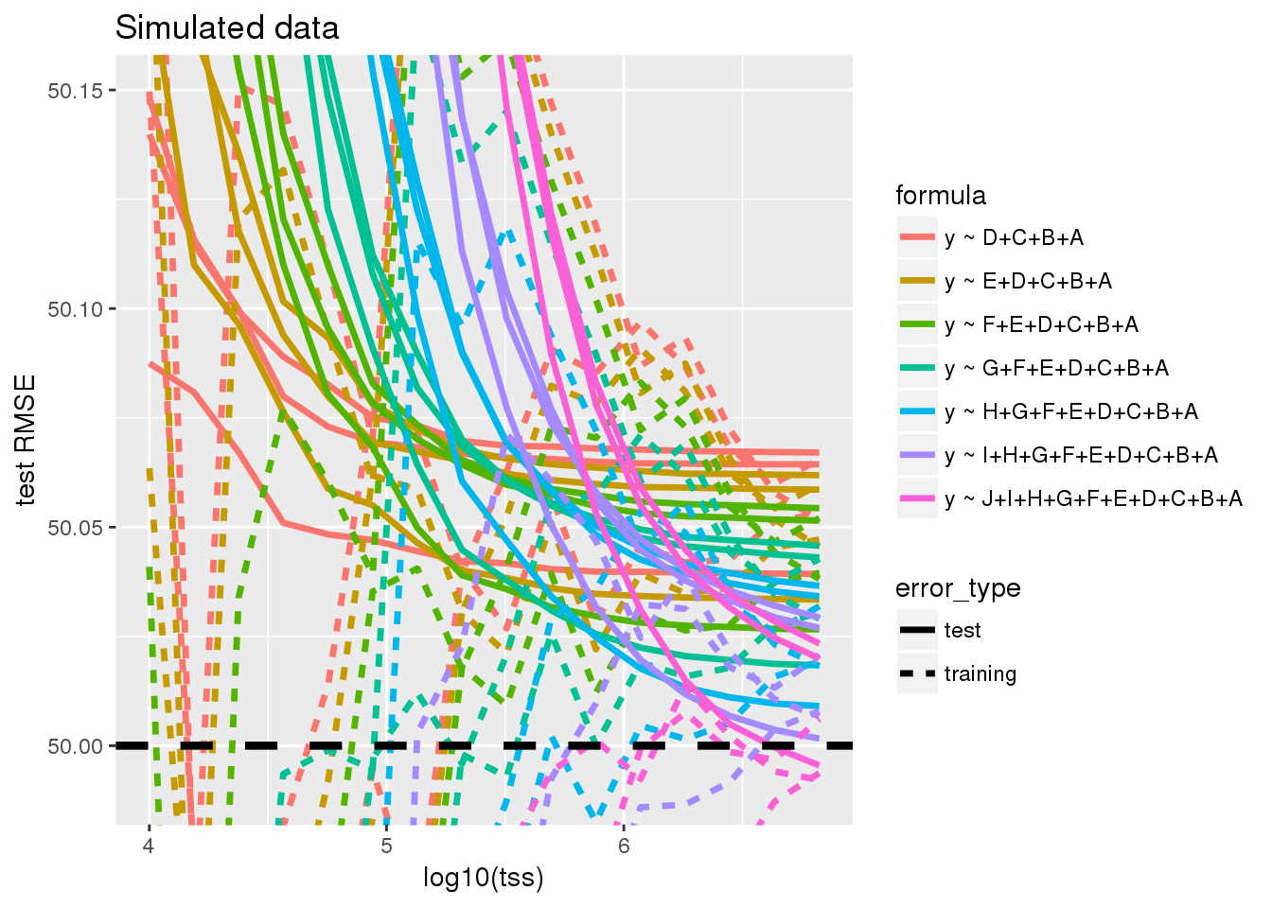

Slide 52
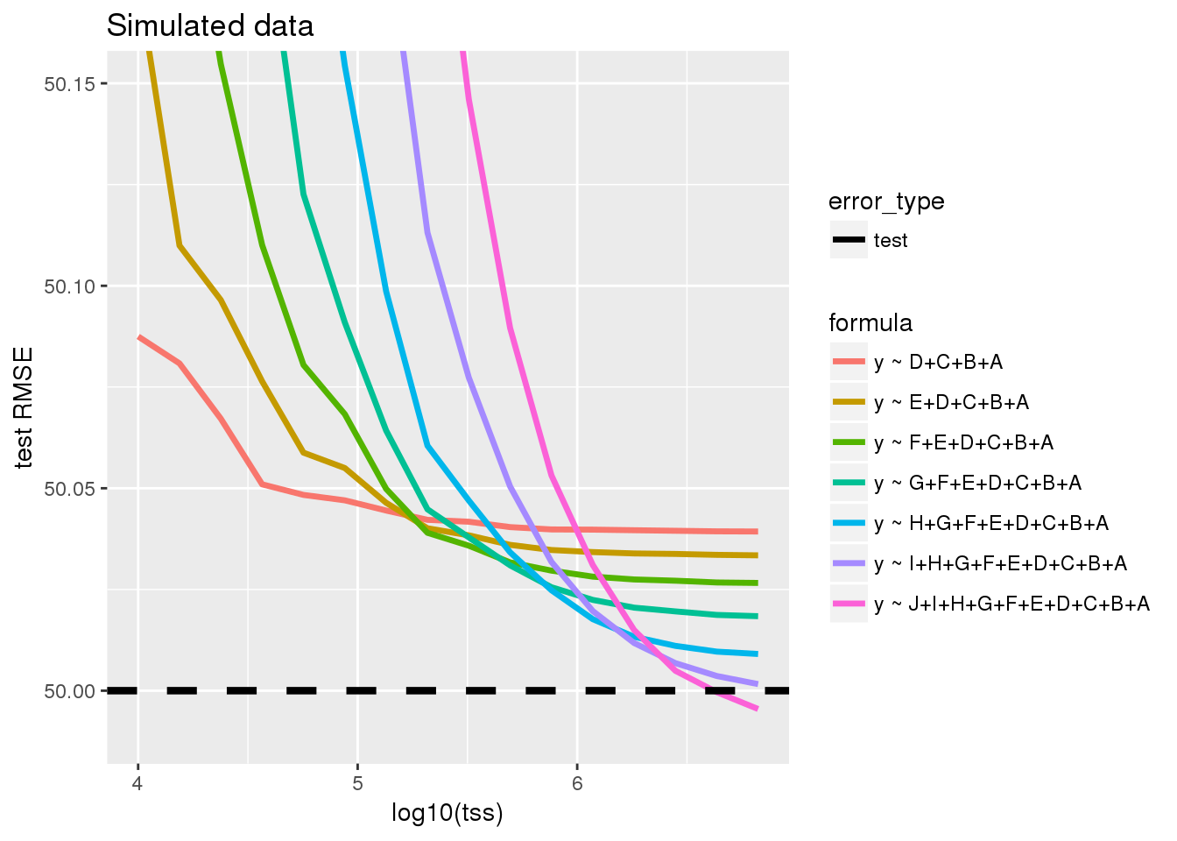

Slide 53
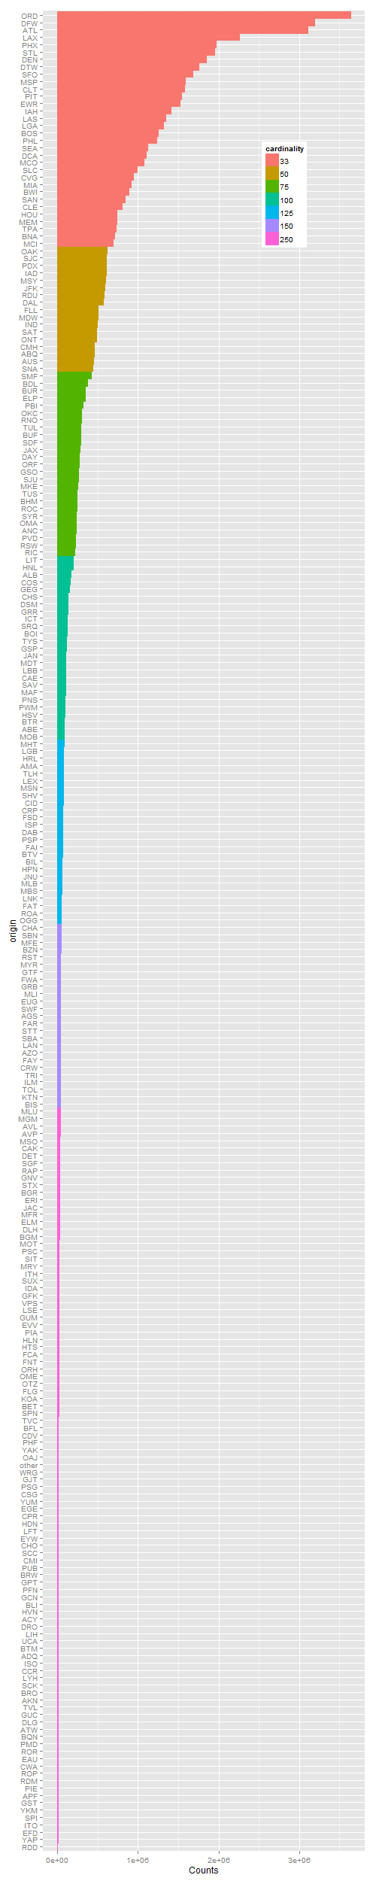
Airline Flight Delay: varying cardinality
Columns added:
Origin33, Dest33,
Origin50, Dest50,
Origin75, Dest75,
Origin100, Dest100,
Origin125, Dest125,
Origin150, Dest150,
Origin250, Dest250

Slide 54
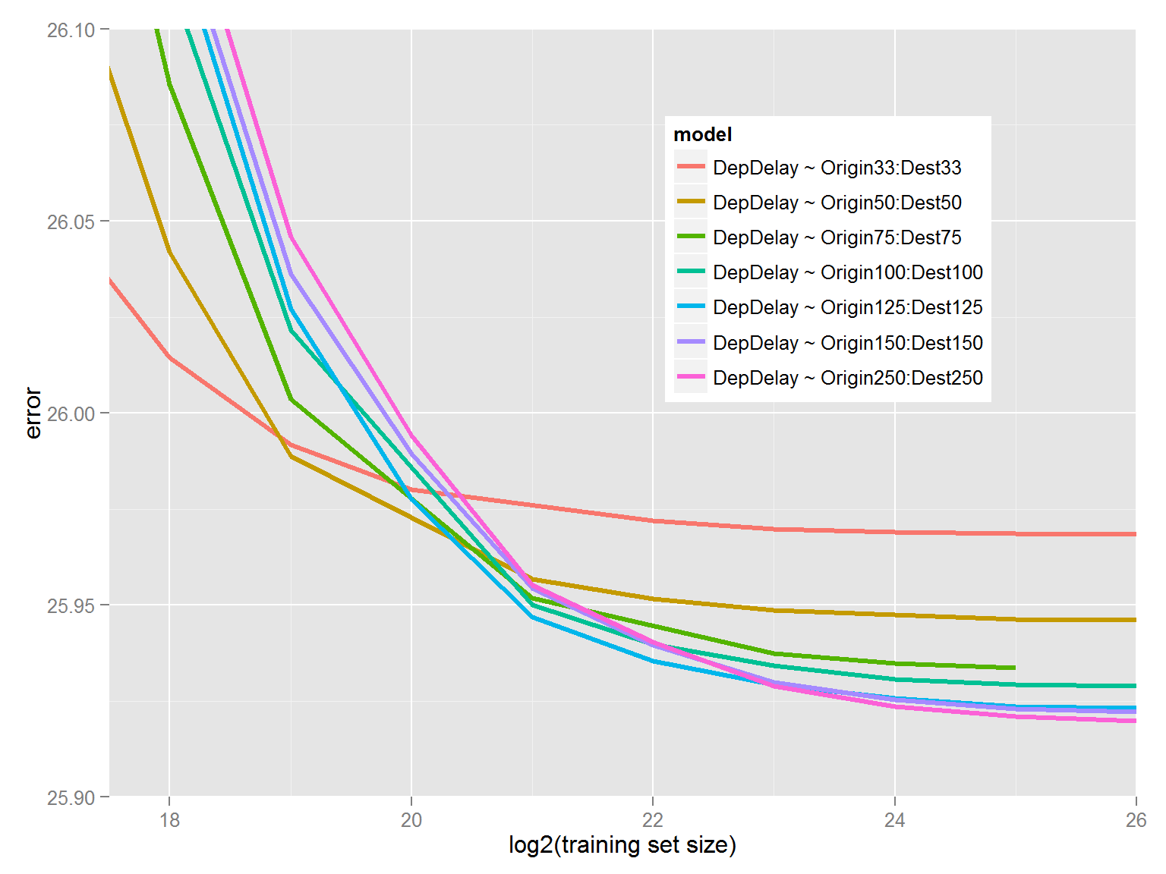

Slide 55
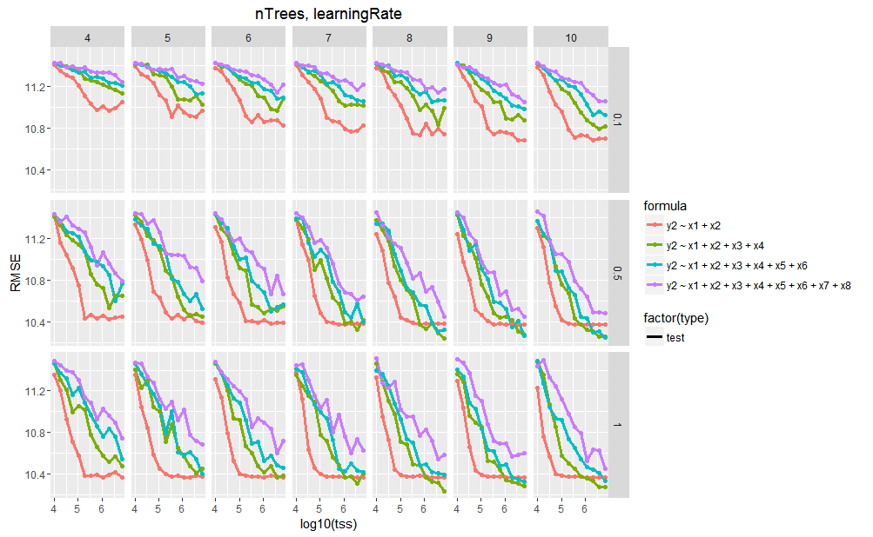
Tuning Boosted Trees

Slide 56
Parallelizing models: training and deploying many parallel models for hierarchical time series optimization
Vanja Paunic
56

Slide 57
Comparisons
Katherine Zhao
57

Slide 58
Base and scalable approaches comparison
Approach | Scalability | Spark | Hadoop | SQL Server | Teradata | Support
CRAN R1 | Single machines |  |  |  |  | Community
SparkR | Single + Distributed computing | X |  |  |  | Community
sparklyr | Single + Distributed computing | X |  |  |  | Community
h2o | Single + Distributed computing | X | X |  |  | Community
RevoScaleR | Single + Distributed computing | X | X | X | X | Enterprise
CRAN R indicates no additional R packages installed
58

Slide 59
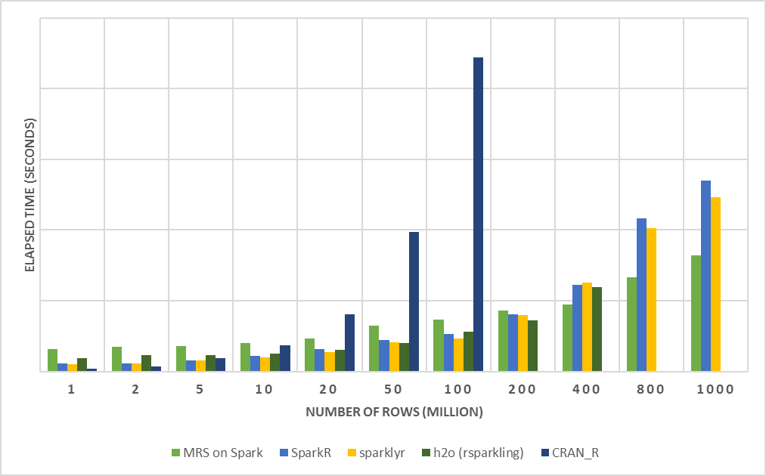
R Server on Spark - faster and more scalable
E2E Process:
Load Data from .csv
Transform Features
Split Data: Train + Test
Fit Model: Logistic Regression (no regularization)
Predict and Write Outputs
Configuration:
1 Edge Node: 16 cores, 112GB
4 Worker Nodes: 16 cores, 112GB
Dataset: Duplicated Airlines data (.csv)
Number of columns: 26
tinyurl.com/Strata2017R/Performance_Comparison
59

Slide 60
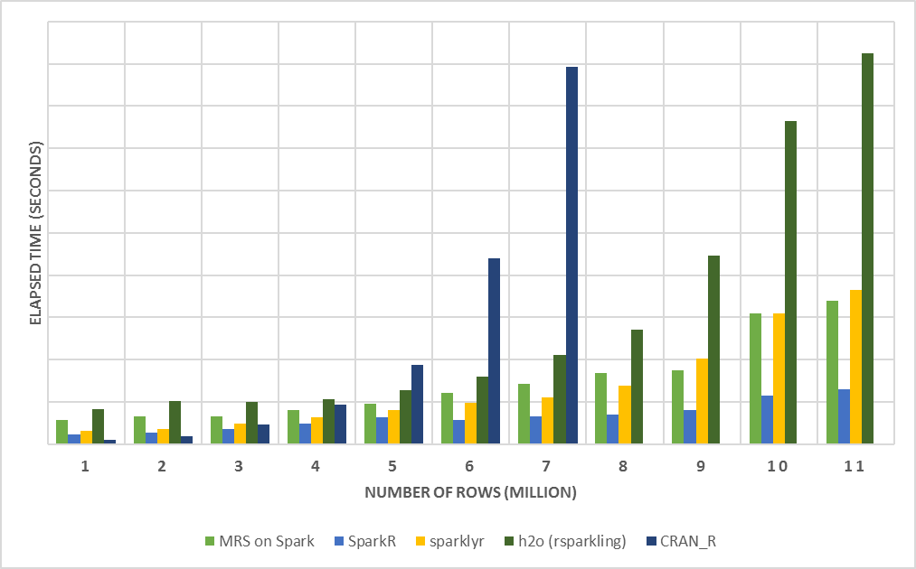
SparkR - outperform when loading data
Load Data:
MRS on Spark: XDF
SparkR: Spark DF
sparklyr: Spark DF
h2o: H2OFrame
CRAN R: DF
Configuration:
1 Edge Node: 16 cores, 112GB
4 Worker Nodes: 16 cores, 112GB
Dataset: Duplicated Airlines data (.csv)
Number of columns: 26
60

Slide 61
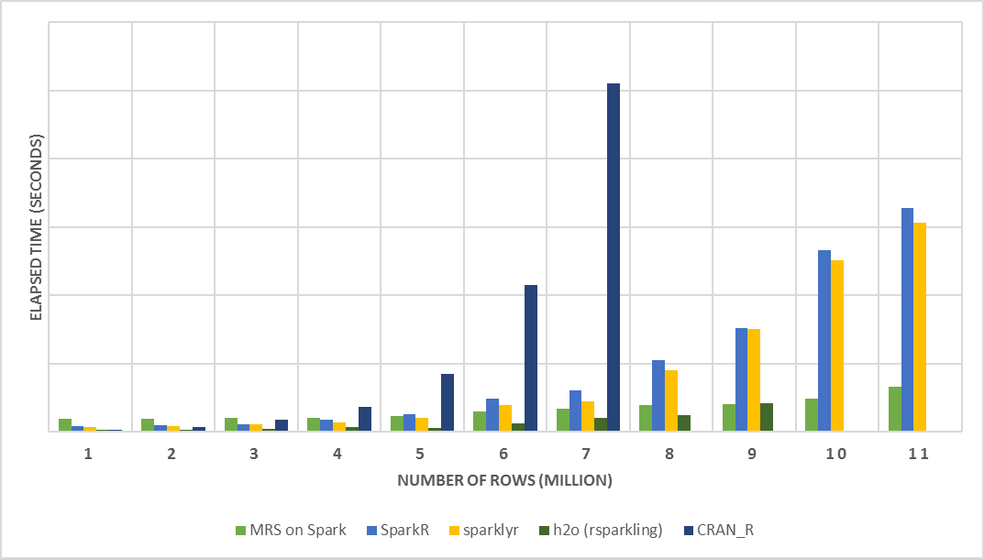
MRS - faster when fitting big data
Configuration:
1 Edge Node: 16 cores, 112GB
4 Worker Nodes: 16 cores, 112GB
Dataset: Duplicated Airlines data (.csv)
Number of columns: 26
61

Slide 62
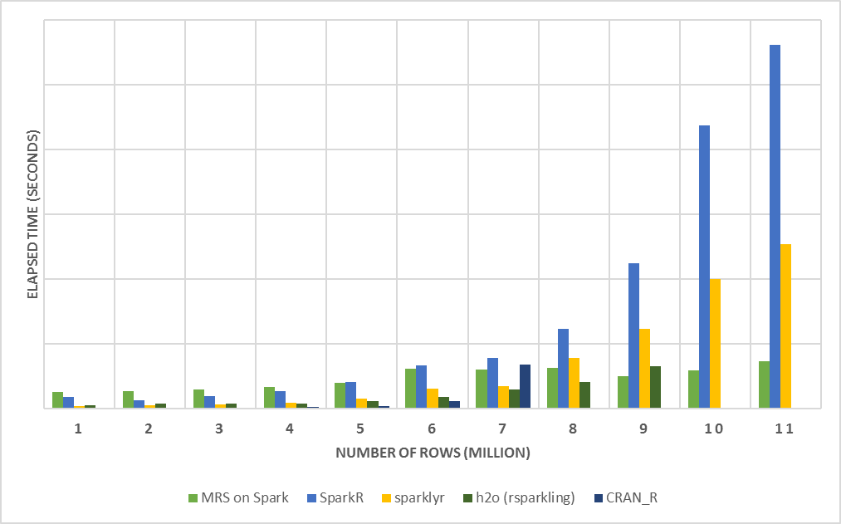
MRS - save time when making predictions
Predict:
Outputs predictions into files in HDFS
Configuration:
1 Edge Node: 16 cores, 112GB
4 Worker Nodes: 16 cores, 112GB
Dataset: Duplicated Airlines data (.csv)
Number of columns: 26
62

Slide 63
Other Options for Scaling R Scripts
Katherine Zhao
63

Slide 64
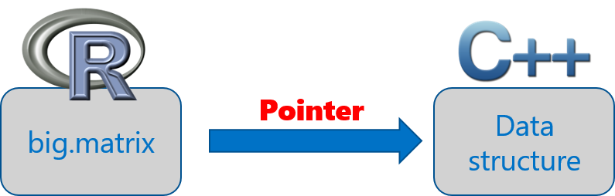
The bigmemory project
Coined by Michael Kane and John Emerson at Yale University
bigmemory works with massive matrix-like objects in R
Combines memory and file-backed data structures: analyze numerical data larger than RAM
The data structures may be allocated to shared memory
Source: “The Bigmemory Project” by Michael Kane and John Emerson: April 29, 2010.

Slide 65
sister packages and related work
biganalytics: provides exploratory data analysis functionality on big.matrix
bigtabulate: adds table-, tapply-, and split-like behavior for big.matrix
bigalgebra: performs linear algebra calculations on big.matrix and R matrix
synchronicity: supports synchronization and may eventually support interprocess communication (ipc) and message passing
biglm: provides linear and generalized linear models on big.matrix
Rdsm: enables shared-memory parallelism with big.matrix
Source: “The Bigmemory Project” by Michael Kane and John Emerson: April 29, 2010.
65

Slide 66
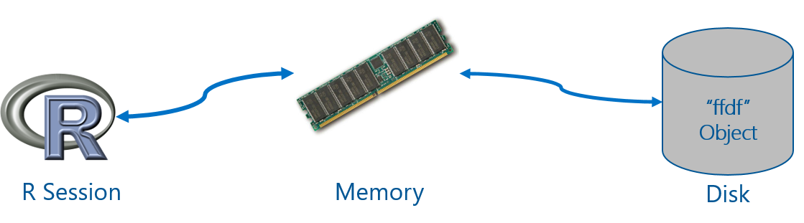
ff package
Provides data structures that are stored on Disk, but behave as if they were in RAM
Maps only a section in main memory for effective consumption
Accepts numeric and characters as input data
Source: ff: memory-efficient storage of large data on disk and fast access functions.
66

Slide 67
ff related packages
ffbase: adds basic statistical functionality to ff. (Note: *.ff apply on ff vectors, and *.ffdf apply on ffdf.)
Coercions: as.character.ff(), as.Date_ff_vector(), as.ffdf.ffdf(), as.ram.ffdf()
Selections: subset.ffdf(), ffwhich(), transform.ffdf(), within.ffdf(), with.ffdf()
Aggregations: quantile.ff(), hist.ff(), sum.ff(), mean.ff(), range.ff(), tabulate.ff()
Algorithms: bigglm.ffdf()
biglars: provides least-angle regression, lasso and stepwise regression on ff.
Source: CRAN Task View: High-Performance and Parallel Computing with R, by Dirk Eddelbuettel.
67

Slide 68
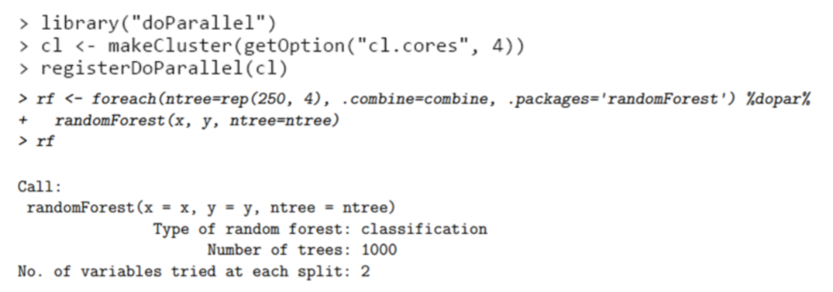
Parallel programming with foreach
Provides a function foreach and two operators %do% and %dopar% that support parallel execution
%dopar% operator relies on a pre-registered parallel backend – doParallel(parallel), doSNOW(snow), doMC(multicore) , doMPI(Rmpi)and etc.
Source: foreach package.
68

Slide 69
Q & A
CONTACT INFORMATION
Vanja Paunic (vanja.paunic@microsoft.com)
Robert Horton (rhorton@microsoft.com)
Hang Zhang (hangzh@microsoft.com)
Srini Kumar (srini.kumar.private@gmail.com)
Mengyue (Katherine) Zhao (mez@microsoft.com)
John-Mark Agosta (joagosta@microsoft.com)
Mario Inchiosa (marioinc@yahoo.com)
Debraj GuhaThakurta (deguhath@microsoft.com)
69

Slide 70
THANK YOU

Slide 71
Backups

Slide 72










Parallelized & Distributed Analytics
ETL
Statistical Tests
Machine Learning
Data import – Delimited, Fixed, SAS, SPSS, OBDC
Variable creation & transformation
Recode variables
Factor variables
Missing value handling
Sort, Merge, Split
Aggregate by category (means, sums)
Chi Square Test
Kendall Rank Correlation
Fisher’s Exact Test
Student’s t-Test
Decision Trees
Decision Forests
Gradient Boosted Decision Trees
Naïve Bayes
Predictive Statistics
Clustering
Sum of Squares (cross product matrix for set variables)
Multiple Linear Regression
Generalized Linear Models (GLM) exponential family distributions: binomial, Gaussian, inverse Gaussian, Poisson, Tweedie. Standard link functions: cauchit, identity, log, logit, probit. User defined distributions & link functions.
Covariance & Correlation Matrices
Logistic Regression
Predictions/scoring for models
Residuals for all models
K-Means
Descriptive Statistics
Sampling
Min / Max, Mean, Median (approx.)
Quantiles (approx.)
Standard Deviation
Variance
Correlation
Covariance
Sum of Squares (cross product matrix for set variables)
Pairwise Cross tabs
Risk Ratio & Odds Ratio
Cross-Tabulation of Data (standard tables & long form)
Marginal Summaries of Cross Tabulations
Subsample (observations & variables)
Random Sampling
Simulation
Simulation (e.g. Monte Carlo)
Parallel Random Number Generation
Custom Parallelization
Variable Selection
rxDataStep
rxExec
PEMA-R API
Stepwise Regression
72

Slide 73
Portable across multiple platforms
Windows
Linux
HDInsight
Cloud
Hortonworks
Cloudera
MapR
Hadoop & Spark
R Server Technology
R Server portfolio
EDW
SQL Server 2016
Teradata Database
R+CRAN
Microsoft R Client
Operationalization
DistributedR
RDBMS
SQL Server 2016 EE
SQL Server 2016 SE
ConnectR
Desktops & Servers
Windows
Linux (Ubuntu, SUSE, RedHat)
ScaleR
high-speed and direct connectors to HDFS, Teradata, SAS and etc.
provides fully-parallelized analytics
includes distributed computing framework and cross-platform portability
“mrsdeploy” establishes remote execution and publishes & manages web services
73

Slide 74
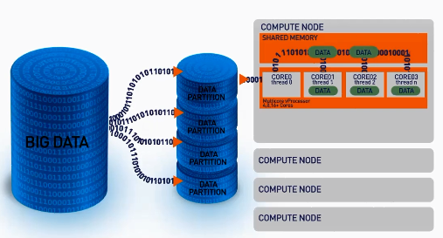
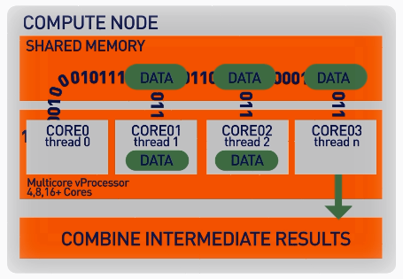
ScaleR: parallel + Big Data
Our ScaleR algorithms work inside multiple cores / nodes in parallel at high speed
Stream data into blocks from sources: Hive tables, CSV, Parquet, XDF, ODBC and SQL Server.
Interim results are collected and combined analytically to produce the output on the entire data set
XDF file format is optimised to work with the ScaleR library and significantly speeds up iterative algorithm processing.
74

Slide 75
Write Once - Deploy Anywhere
ScaleR models can be deployed from a server or edge node to run in Spark/Hadoop without any functional R model re-coding.
Local Parallel processing - Linux or Windows
In – Spark/Hadoop
### SETUP LOCAL ENVIRONMENT VARIABLES ###
myLocalCC <- “localpar”
### LOCAL COMPUTE CONTEXT ###
rxSetComputeContext(myLocalCC)
### CREATE LINUX, DIRECTORY AND FILE OBJECTS ###
linuxFS <- RxNativeFileSystem( )
AirlineDataSet <- RxXdfData(“airline_20MM.xdf”,
fileSystem = linuxFS)
### SETUP SPARK/HADOOP ENVIRONMENT VARIABLES ###
mySparkCC <- RxSpark() myHadoopCC <- RxHadoopMR()
### HADOOP COMPUTE CONTEXT ###
rxSetComputeContext(mySparkCC) rxSetComputeContext(myHadoopCC)
### CREATE HDFS, DIRECTORY AND FILE OBJECTS ###
hdfsFS <- RxHdfsFileSystem()
AirlineDataSet <- RxXdfData(“airline_20MM.xdf”, fileSystem = hdfsFS)
Compute context R script - sets where the model will run
Functional model R script – does not need to change to run in Spark
### ANALYTICAL PROCESSING ###
### Statistical Summary of the data
rxSummary( ~ ArrDelay + DayOfWeek, data = AirlineDataSet, reportProgress = 1)
### CrossTab the data
rxCrossTabs(ArrDelay ~ DayOfWeek, data = AirlineDataSet, means = T)
### Linear model and plot
hdfsXdfArrLateLinMod <- rxLinMod(ArrDelay ~ DayOfWeek + CRSDepTime, data = AirlineDataSet)
plot(hdfsXdfArrLateLinMod$coefficients)
75

